Slide 1
Factors affecting Life Expectancy
By :
Shahad Alomayrah

Slide 2
Table of contents
01
02
03
Overview
Dataset
Data Preprocessing
04
Build Regression Model
05
Conclusion

Slide 3
Overview
Because a person's life is important and know the factors that factors affecting life
expectancy this study will focus economic factors, social factors and other health
related factors as well Like Schooling, Hepatitis, Income-composition-of-resources

Slide 4
Dataset
Collected the data from Kaggle website
The Global Health Observatory (GHO) data repository under World Health Organization (WHO)
2938 Columns
22 Rows

Slide 5
Data processing
One-hot-encoding
check duplicat
01
02
03
04
05
Rename columns
Check Null
And fill null
Outlier
Winsorize

Slide 6
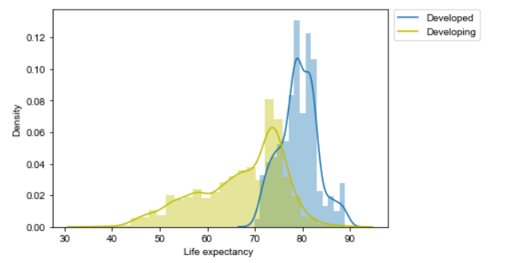
graph

Slide 7
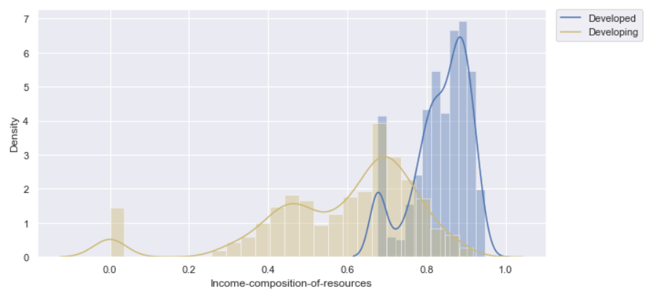
graph

Slide 8
Models
Model | Train | Test | MAE | R2_SCORE
LinearRegression | 0.81 | 0.82 | 2.8 | 0.78
RandomForestRegressor | 0.95 | 0.94 | 1.5 | 0.94

Slide 9
Conclusion
The data were dealt and an analysis Developing countries have a lower life expectancy than developed countries
The best Model RandomForest

Slide 10
Thanks!
Do you have any questions?

